Slide 1



MICROCONTROLLER BASED SYSTEM DESIGN
CSE 3215
Lecture 7

Slide 2
Operational Amplifier
Operational amplifiers are linear devices that have all the properties required for nearly ideal DC amplification and are therefore used extensively in signal conditioning, filtering or to perform mathematical operations such as add, subtract, integration and differentiation.

Slide 3
Operational Amplifier
An Operational Amplifier, or op-amp for short, is fundamentally a voltage amplifying device designed to be used with external feedback components such as resistors and capacitors between its output and input terminals. These feedback components determine the resulting function or “operation” of the amplifier and by virtue of the different feedback configurations whether resistive, capacitive or both, the amplifier can perform a variety of different operations, giving rise to its name of “Operational Amplifier”.

Slide 4
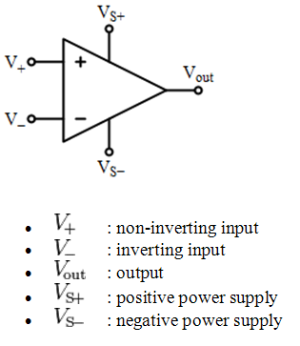
Circuit Symbol and Terminals

Slide 5
OP-AMP Terminals
Op amps have five basic terminals:
Two for supply power
Two for input signals
One for output

Slide 7
Offset null voltage definition
Input offset voltage is defined as the voltage that must be applied between the two input terminals of an op amp to null or bring the output voltage to zero.
The offset null effectively applies this voltage to ensure that the offset
is removed from the output.

Slide 8
Op amp Offset Nulling
Most of the OPAMP has an Offset voltage at the output even if the input voltages are same. To make the output to zero voltage, the offset nulling method is used.
In most Op-Amps there is a small offset because of their inherent property and results from the mismatches in the input bias arrangement.

Slide 9
Op amp Offset Nulling
So a small output voltage is available at the output of some Op-amps
even if the input signal is zero.
This drawback can be rectified by providing a small offset voltage to the inputs. This is known as the Input Offset voltage.
To remove or Null the Offset, most Op-Amps have two pins to enable the offset nulling. For this, a Pot with a typical value of 100K should be connected between the pins 1 and 5 with its Wiper to the ground. By adjusting the pot, output can be set at Zero voltage.

Slide 10
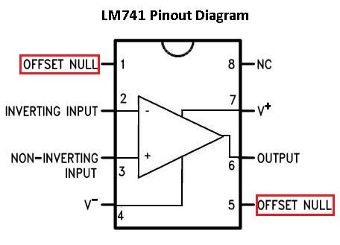
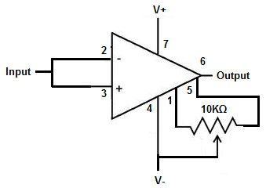
Op amp Offset Nulling

Slide 11
Types of gain
4 types of gain in OPAMPs:
Voltage gain – Voltage in and voltage out
Current gain – Current in and Current out
Transconductance – Voltage in and Current out
Trans resistance – Current in and voltage out

Slide 12
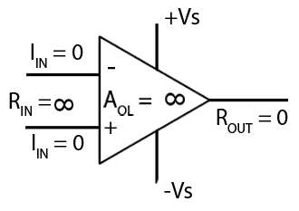
The Ideal Op-Amp

Slide 13
Idealized Characteristic
Open Loop gain
Infinite - Open loop gain is the gain of the Op Amp without a positive or negative feedback. An ideal OP Amp should have an
infinite open 2, 00000.
Input impedance
loop gain but typically it range between 20,000 and
Infinite – Input impedance is the ratio of input voltage to input current and is assumed to be infinite to prevent any current flowing from the source supply into the amplifiers input circuitry ( I_{IN} = 0 ). Real op-amps have input leakage currents from a few pico-amps to a few milli-amps.

Slide 14
Idealized Characteristic
Output impedance
Zero – The ideal Op Amp should have zero output impedance without any internal resistance. So that it can supply full current to the load connected to the output. Real op-amps have output impedances in the 100-20kΩ range.
Bandwidth
Infinite – The ideal Op Amp should have an infinite frequency response so that it can amplify any frequency from DC signals to the highest AC frequencies. But real Op Amps have limited bandwidth.

Slide 15
Idealized Characteristic
Offset Voltage
Zero – The amplifiers output will be zero when the voltage difference between the inverting and the non-inverting inputs is zero, the same or when both inputs are grounded. Real op-amps have some amount of output offset voltage.
From these “idealized” characteristics above, we can see that the input resistance is infinite, so no current flows into either input terminal (the “current rule”) and that the differential input offset voltage is zero (the “voltage rule”). It is important to remember these two properties as they will help us understand the workings of the Operational Amplifier with regards to the analysis and design of op-amp circuits.

Slide 16
Ideal Op-Amp VS Typical Op Amp
Topic | Ideal Op-Amp | Typical Op-Amp
Input Resistance | Infinite | 10⁶ Ω
Input Current | 0 | 10⁻¹² to 10⁻⁸
Output Resistance | 0 | 100 to 1000 Ω
Operational Gain | Infinite | 10⁵ to 10⁹
Bandwidth | Infinite | Attenuates and phases at high frequencies
Temperature | Independent | Depends of bandwidth and gain

Slide 17
OPAMP applications
Amplification
Comparator
Signal Modulation
Filters
Voltage follower
Mathematical Operations
Voltage-Current signal conversion

Slide 18
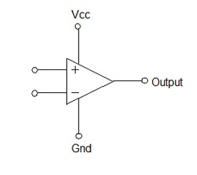
Amplification
The amplified output signal from the Op Amp is the difference between the two input signals multiplied by the open loop gain.
Output Voltage = Differential input voltage
x Open-loop gain
V_{o} = E_{d} x A_{OL}
Where,
Ed = voltage at the (+) input - voltage at the (-)input

Slide 19
Amplification
If both the inputs are supplied with the same voltage, the Op Amp will
then takes the difference between the two voltages and it will be 0.
The Op Amp will multiply this with its gain 1,000,000 so the output voltage is 0.
When 2 volts is given to one input and 1 volt in the other, then the Op Amp will takes its difference and multiply with the gain. That is 1 volt x 1,000,000.
But this gain is very high so to reduce the gain, feedback from the
output to the input is usually done through a resistor.

Slide 20
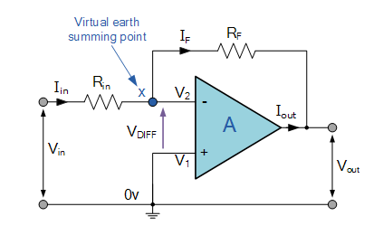
Inverting Amplifier
The circuit shown above is an inverting amplifier with the Non inverting input connected to the ground.
Two resistors R_{in} and R_{F} are connected in the circuit in such a fashion that R_{in} feeds the input signal while R_{F} returns the output to the Inverting input.
Here when the input signal is positive the output will be negative and vice versa.

Slide 21
Inverting Amplifier
In this Inverting Amplifier circuit the operational amplifier is connected with feedback to produce a closed loop operation. When dealing with operational amplifiers there are two very important rules to remember about inverting amplifiers, these are: “No current flows into the input terminal” and that “V1 always equals V2”. However, in real world op-amp circuits both of these rules are slightly broken.
There are two very important rules to remember about Inverting Amplifiers or any operational amplifier for that matter and these are.
No Current Flows into the Input Terminals
The Differential Input Voltage is Zero as V1 = V2 = 0 (Virtual Earth)

Slide 22
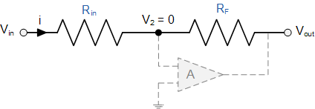
Inverting Amplifier
Then by using these two rules we can derive the equation for calculating
the closed-loop gain of an inverting amplifier, using first principles.
Current ( i ) flows through the resistor network as shown.

Slide 23
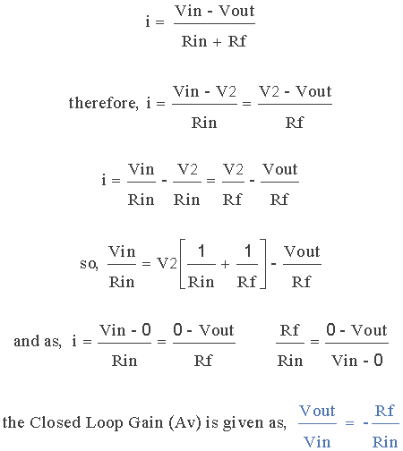
Inverting Amplifier

Slide 24
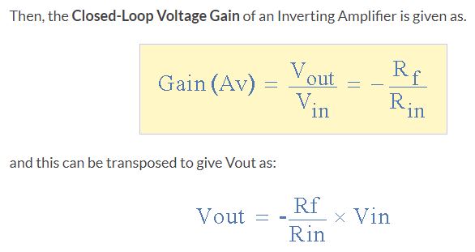
Inverting Amplifier

Slide 25
Virtual Ground
As the name indicates it is virtual, not real ground.
For some purposes we can consider it as equivalent to ground.
In op-amp the term virtual ground means that the voltage at that particular node is almost equal to ground voltage (0V).
It is not physically connected to ground.
This concept is very useful in analysis of op-amp circuits and it will make a lot of calculations very simple.

Slide 26
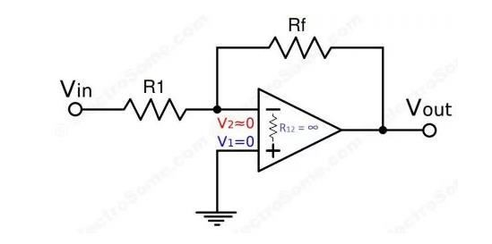
Virtual Ground

Slide 27
Virtual Ground
Using Infinite Voltage Gain
We already know that an ideal opamp will provide infinite voltage gain. For real opamps also the gain will be very high such that we can consider it as infinite for calculation purposes.
Gain = Vo/Vin
As gain is infinite, Vin = 0
Vin = V2 – V1
In the above circuit V1 is connected to ground, so V1 = 0. Thus V2 also will be at ground potential.
V2 = 0

Slide 28
Virtual Ground vs Real Ground
Virtual Ground
Virtual Ground is a concept that made for easy explantaion and
calculation purposes.
Voltage is approximately Zero
Not electrically connected to Ground

Slide 29
Virtual Ground vs Real Ground
Real Ground
Real Ground is a terminal which is physically connected to ground or earth which acts as the reference point for the entire circuit.
Voltage is Zero
Electrically connected to Ground

Slide 30
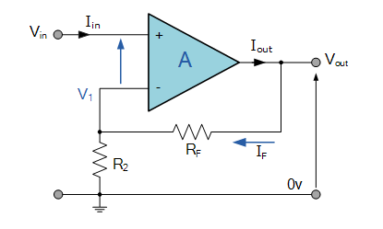
Non-Inverting Amplifier
In this configuration,
the input is applied
voltage signal, ( )
directly to the non-inverting ( + )
^{V}IN
input terminal which means that the output gain of the amplifier becomes “Positive” in value.
The result of this is that the output signal is “in-phase” with the input signal.

Slide 31
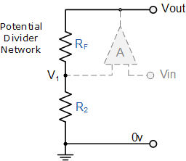
Non-Inverting Amplifier
Equivalent Potential Divider Network

Slide 32
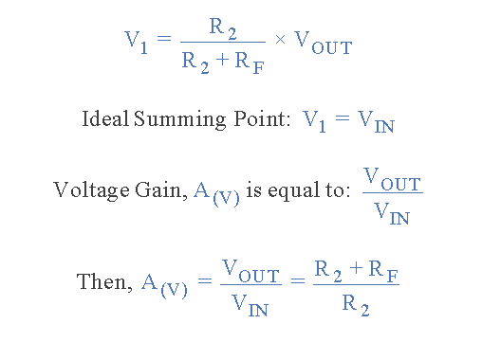
Non-Inverting Amplifier
Then using the formula to calculate the output voltage of a potential divider network, we can calculate the closed-loop voltage gain ( A_{V} ) of the Non- inverting Amplifier as follows:

Slide 33
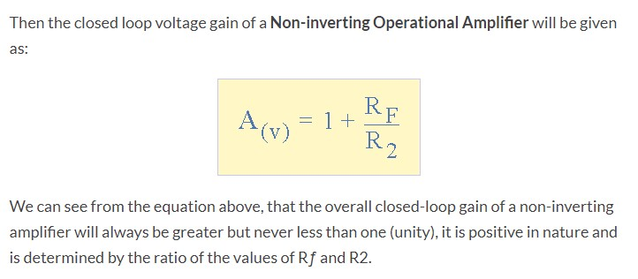
Non-Inverting Amplifier

Slide 34
SUMMING-POINT CONSTRAINT
Operational amplifiers are almost always used with negative feedback, in which part of the op-amp output signal is returned to the input in opposition to the source signal.
Assume that the differential input voltage and the input current of the op-amp are forced to zero. This is summing point constraint.

Slide 35
Ideal op-amp circuits are analyzed by the following steps:
Verify that negative feedback is present.
Assume that the differential input voltage and the input current of the op amp are forced to zero. (This is the summing- point constraint.)

Slide 36
Voltage Follower
A voltage follower is an op-amp circuit which has a voltage gain
of 1.
This means that the op amp does not provide any amplification to the signal. The reason it is called a voltage follower is because the output voltage directly follows the input voltage, meaning the output voltage is the same as the input voltage.
Thus, for example, if 10V goes into the op amp as input, 10V
comes out as output. A voltage follower
acts as a
to the
buffer,
signal.
providing no amplification or attenuation

Slide 37
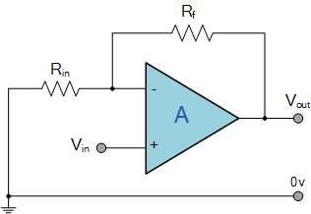
Voltage Follower
If we made the feedback resistor, R equal to zero, (Rƒ = 0), and resistor R2 equal to infinity, (R2 = ∞), then the circuit would have a fixed gain of “1” as all the output voltage would be present on the inverting input terminal (negative feedback). This would then produce a special type of the
R_{f}
R₂
^{V}out
^{V}in
non-inverting amplifier circuit called a Voltage Follower or also called a “unity gain buffer”.

Slide 38
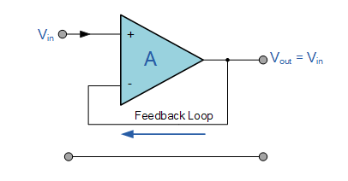
Voltage Follower
As the input voltage Vin is applied to the non-inverting input the gain of the amplifier is given as:
V_{out} = A (V_{in}) therefore Gain , (A_{v}) = V_{out}/V_{in} = 1

Slide 39
Purpose of a Voltage Follower
Voltage Followers Draw Very Little Current
Voltage Followers Are Important in Voltage Divider Circuits

Slide 40
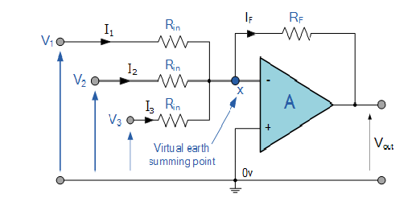
The Summing Amplifier
The Summing Amplifier is another type of operational amplifier circuit configuration that is used to combine the voltages present on two or more inputs into a single output voltage.

Slide 41
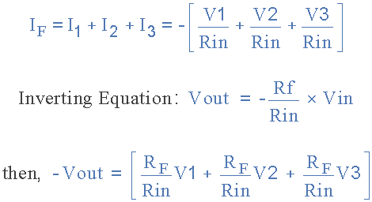
The Summing Amplifier
In this simple summing amplifier circuit, the output voltage, ( Vout ) now becomes proportional to the sum of the input voltages, V1, V2, V3, etc. Then we can modify the original equation for the inverting amplifier to take account of these new inputs thus:

Slide 42
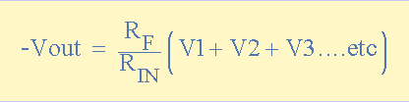
The Summing Amplifier
However, if all the input impedances, ( Rin ) are equal in value, we can simplify the
above equation to give an output voltage of:

Slide 43

THANK YOU

